Slide 1
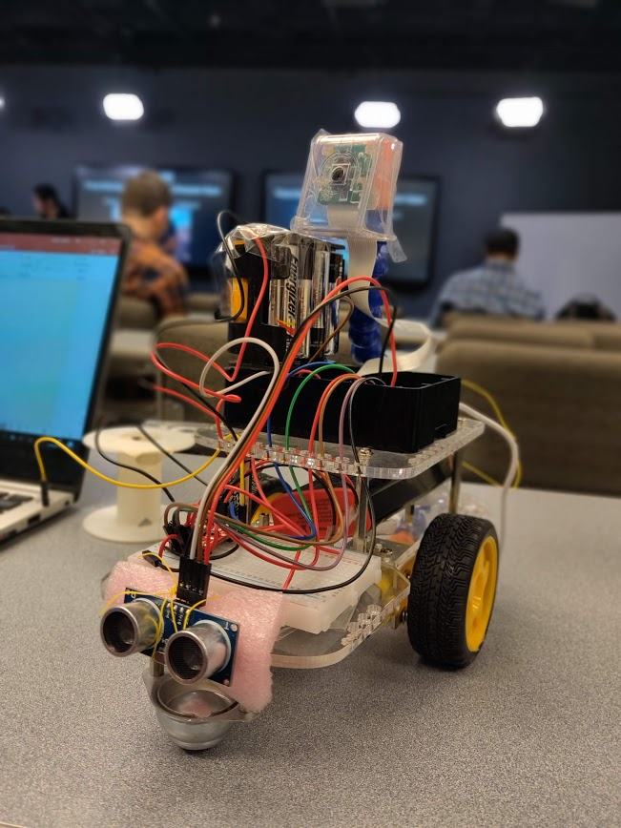
SIGN FOLLOWING BOT
Team Members: -
Ayush Dhoot
Siddhant Jajoo
Satya Mehta

Slide 2
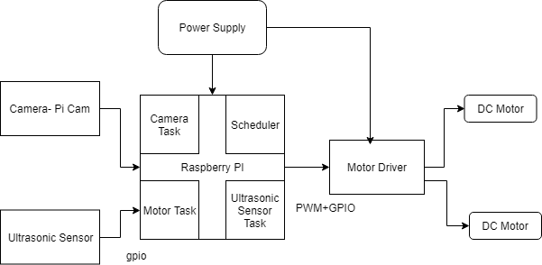
Block Diagram

Slide 3
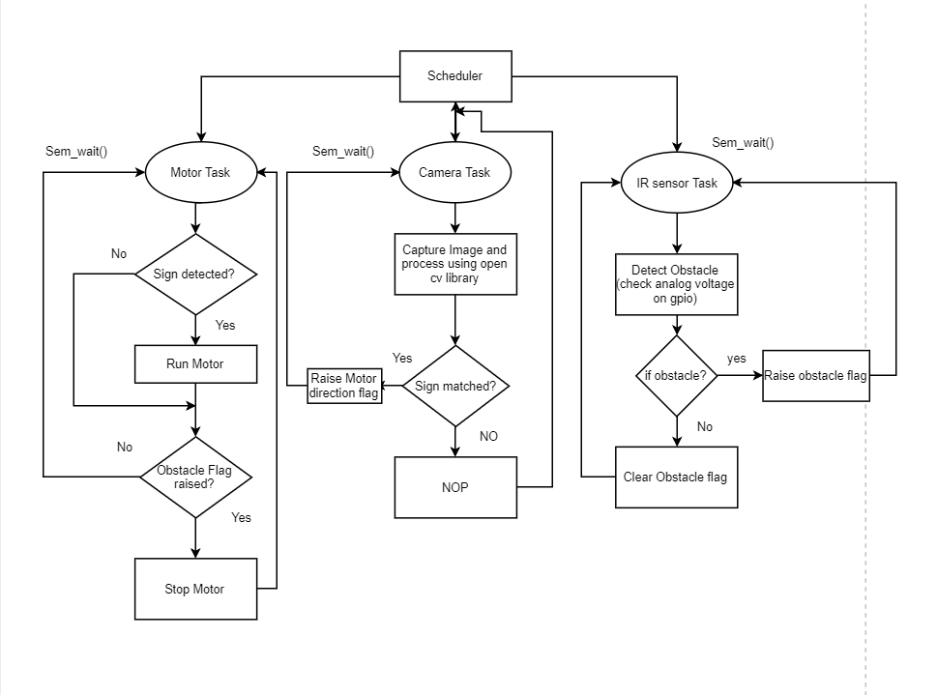
Software Flow Chart

Slide 4
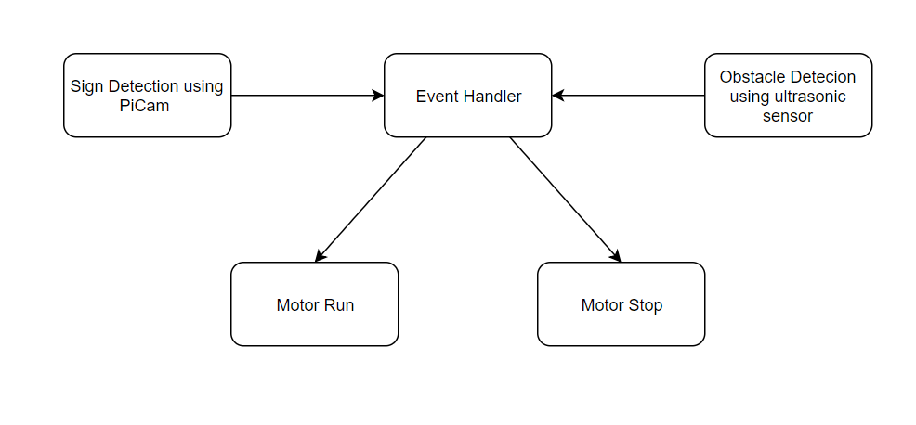
Control Flow Diagram

Slide 5
Capability Requirements
Raspberry Pi camera interface.
DC Motors interfaced using H Bridge motor driver.
Ultrasonic sensor interface to detect obstacles.
Three services scheduled using Rate Monotonic Policy.
Scheduler posts semaphores of the services at pre determined frequency.

Slide 6
Priority requirements
Motor task must have highest priority as the control of the bot depends upon the motor state and the sensor and camera flags.
Obstacle detection must have higher priority than camera as the bot should detect obstacle of any kind and stop accordingly to avoid collision.
Camera capture task has the least priority of these task as the detection of the sign is not the most frequent at hand.

Slide 7
Real-Time Requirements
Services | C(ms) | T(ms) | D(ms) | Frequency (Hz)
Motor Service | 1 | 33.33 | 33.33 | 30
Ultrasonic obstacle detection Service | 130 | 250 | 250 | 4
Camera Service | 150 | 500 | 500 | 2

Slide 8
WCET of services
Motor Service has the lowest have WCET (10-20 us) as it just drives the gpio pins depending on the flags.
Obstacle detection service WCET depends on the distance between the object and the sensor (10ms – 130ms).
For one frame camera takes around 150ms to process.

Slide 9
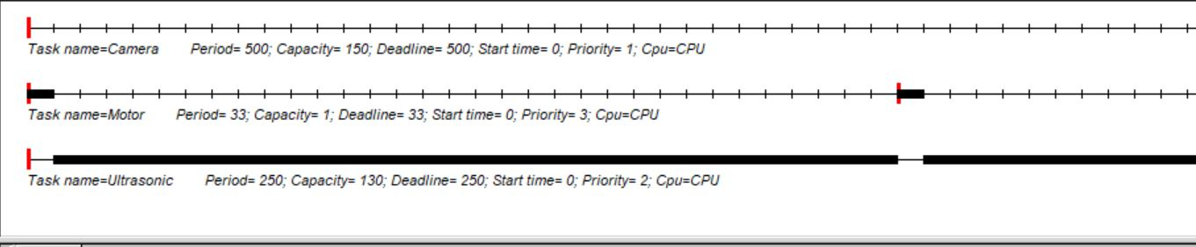
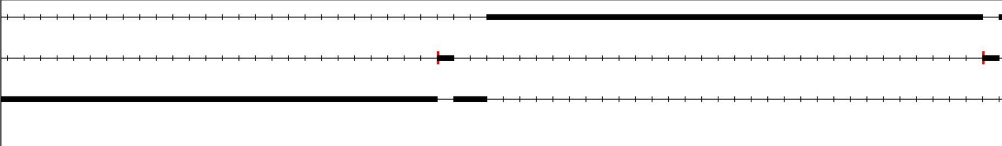
Cheddar Analysis

Slide 10
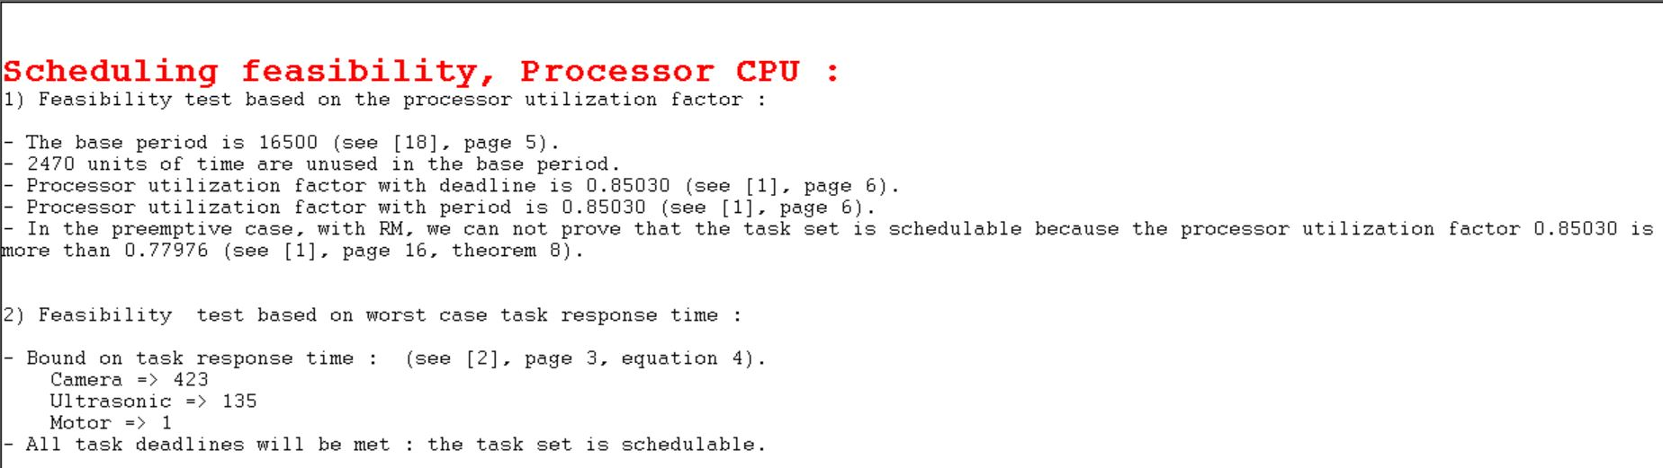

Slide 11
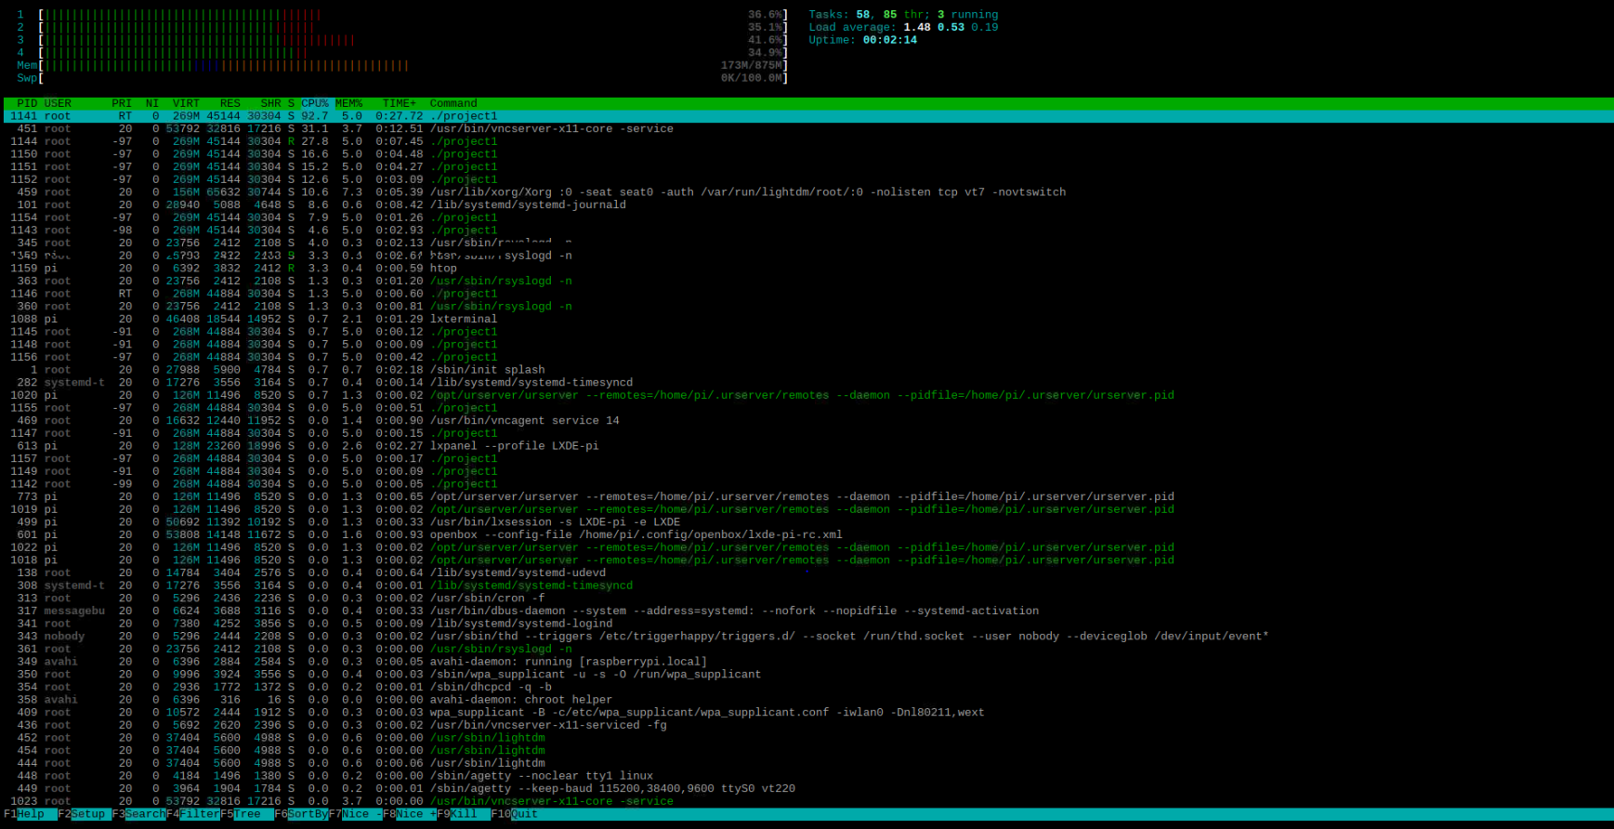
Profiling – using htop

Slide 12
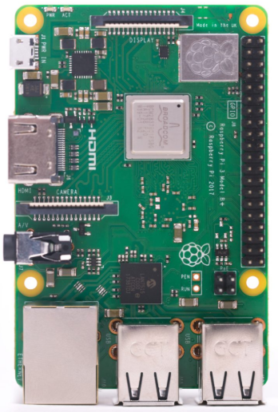
Platform Resources[*]
Raspberry Pi Model 3B+
Broadcom BCM2837B0, Cortex-A53 (ARMv8) 64-bit SoC @ 1.4GHz
1GB LPDDR2 SDRAM
CSI camera port for connecting a Raspberry Pi camera
4 USB 2.0 ports
WiringPi GPIO libraries.
Extended 40-pin GPIO header
WIFI support.

Slide 13
Prototype Implementation
Camera frames captured using OpenCV libraries.
Image detection using Haar Cascade classifiers.
GPIO pins driven by using inbuilt Raspberry Pi libraries.
PWM used to control the speed of the motors.
Obstacle detection service polls echo and trigger pins to calculate distance.
Scheduler implemented as highest priority thread.

Slide 14
Implementation and Analysis
Bot stops whenever YIELD sign is detected at pre determined distance range.
It also stop whenever an obstacle is detected at a distance of 0 to 50 cm.
In all other cases the bot moves forward.
The services are scheduled using RM Policy.
Schedule failed when we tried more than one sign.
WCET of ultrasonic sensor was longer than expected.
If we increase frequency of camera service the schedule was no longer feasible.

Slide 15
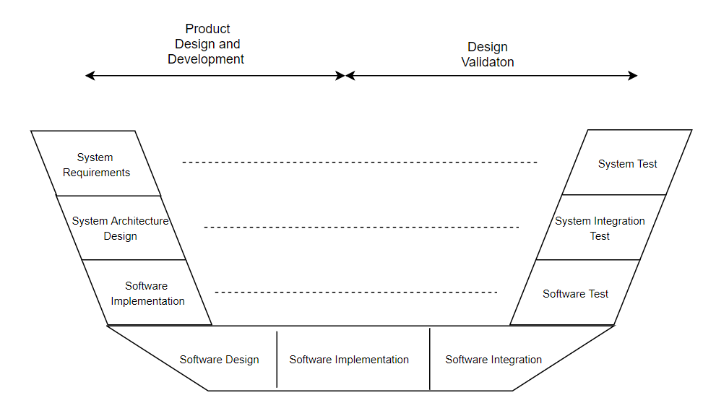
Validation Plan

Slide 16
DEMO TIME

Slide 17
Questions and Answers
Thank You!

